Slide 1
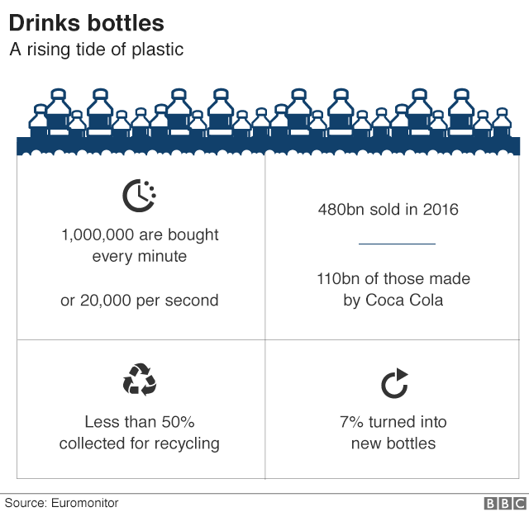


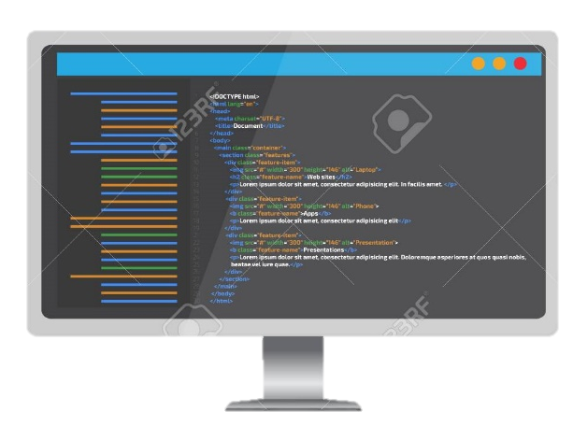



Plastic Waste Profiling
Cost Effective
Scalability
01
Sustainable
02
07
02
Advantages
03
06
03
06
Ease of Use
Customizable
Let’s segregate this waste using technology
04
05
04
05
Reliability
Compatible
TensorFlow python Keras

